Slide 1

Basic Raspberry Pi and embedded systems
By Chuck Duey
September 18th 2019
TM Raspberry Pi Foundation www.raspberrypi.org

Slide 2
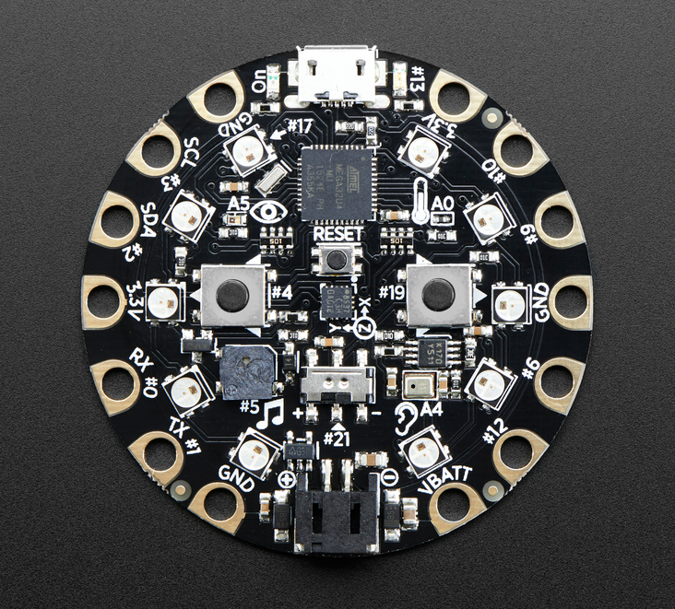
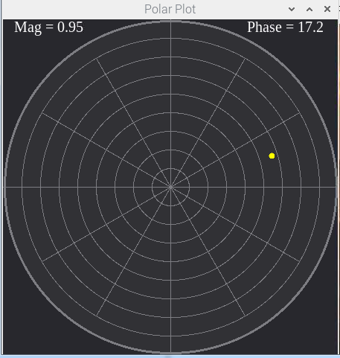
Outline:
TM Raspberry Pi Foundation www.raspberrypi.org
Your project and programming
Different embedded systems
Raspberry Pi Versions.
Tips and Tools for the Raspberry Pi
How to install and update your own “Distro”
Hook up and tour of the standard Linux desktop
Raspberry Pi Packages
Raspberry Pi and Web and LAMP stack
Somethings the Raspberry Pi can do with USB hardware
Raspberry Pi Addon Hardware
Built in interfaces for camera and display
Hats and bonnets
Other Addon Boards
Hands on exercise running and programming the Raspberry Pi

Slide 3
Think About the Scope of Your Project
Many projects try to reach too far. Start simple and improve over the semester.
This a little ahead on what might be wanted. For example, it is easier to get a board with Wi-Fi than add it later.
Does your project need analog I/O? Some systems have it built in, other need addon boards.
Hardware is only part of the picture; most projects need more time to write and debug the software.
When possible have two of any critical hardware piece. At the last minute, hardware breaks or gets damage.
Do not procrastinate!

Slide 4
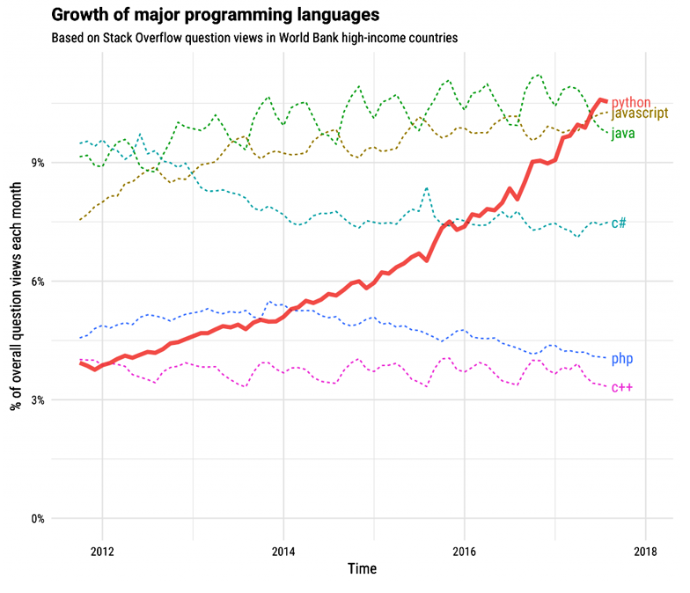
Major Programming Languages

Slide 5
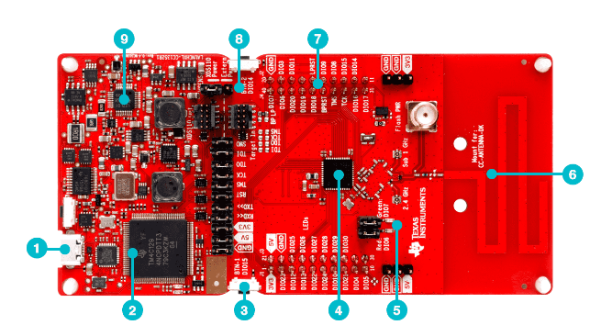
Standalone Microprocessor
Advantages
Targeted size and function. Right for the job.
Low cost.
Many EVM’s for low cost.
Support from the manufacturer.
Full custom design. Can make very small.
Disadvantages
Need to build circuitry.
Not much Open-source hardware or software
Need to pay for high level language cross compilers.
TI LaunchPad™ Development Kit

Slide 6
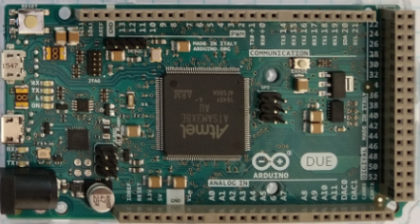
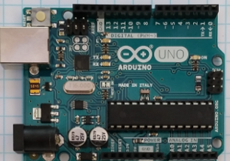
Arduino
Advantages
Many different I/O’s built in including ADC.
Very nice IDE. (Integrated Development Environment)
Huge opensource community for both hardware and software.
Many premade shields and hardware addons.
Disadvantages
ADC lower resolution and slow. Difficult to do audio speeds.
Need to get a Wi-Fi/BT version in advance, or add on for IOT
Not easy to get a high resolution dynamic display.

Slide 7
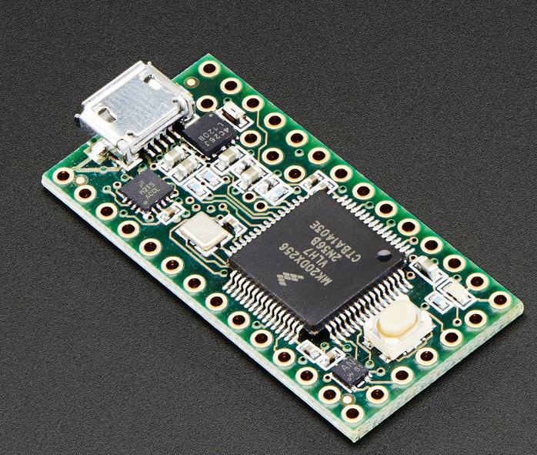
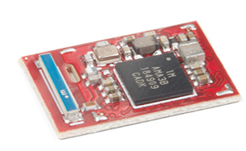
Teensy and Other Small Variants
Arduino like IDE and programming.
Many with Analog I/O.
Very small and low power.
More difficult to prototype with.
ADC lower resolution and slow. Difficult to do audio speeds.
Need to get a Wi-Fi/BT version in advance, or add on for IOT
Teensy 3.2
Adafruit
Circuit Playground
SparkFun Artemis

Slide 8
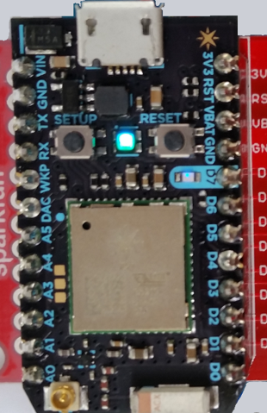
Particle Photon
Advantages
Very small and low power
Uses Arduino like IDE and language.
Is a Wi-Fi device. Very easy to make IoT device.
Full custom design. Can make very small.
Disadvantages
Can only program over the internet.
One processor size and speed 120MHz.
Difficult to connect up dynamically to the internet.
Must have internet connection to start. (use Wi-Fi Hotspot)

Slide 9
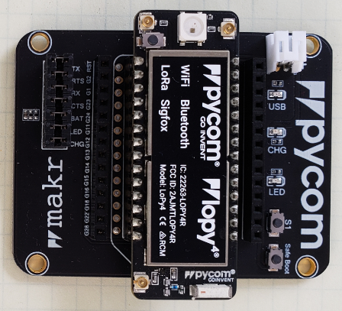
PyCom Boards
Advantages
Very small and low power
Multiple IO 8 X 12 Bit ADC 2x I2C, 2x UART, SPI, GPIO
uPython environment using Atom IDE
Built in AES,DES, and SHA/MD5 Hash
Is Multi standard wireless connections.
Antenna connections for long range
Standalone modules available.
Disadvantages
No Operating system difficult to multi task
Atom interface a bit difficult
Need adapter board to program and connect to I/O.
Difficult to set up dynamic webpages.
No standard display

Slide 10
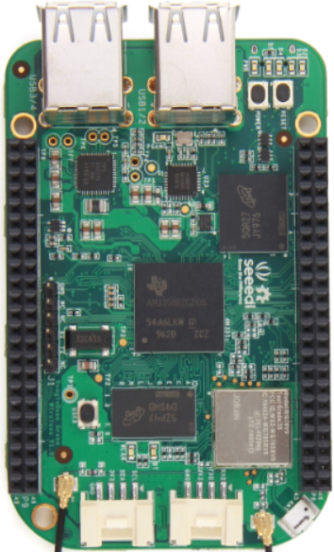
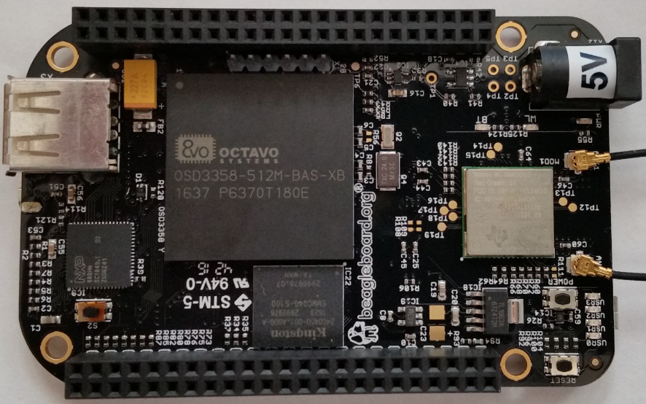
BeagleBone
Advantages
Linux operating system. Can program in many languages and interact with the internet.
Can make Webpages and run full LAMP stack.
Open source software and hardware support.
Fast ARM core processor.
The Black Version has a micro HDMI display.
Analog inputs!!!
Disadvantages
Display resolution not that good.
Single Core ARM Processors.
Operating system overhead.
Costs more than Raspberry Pi
Community support is not as wide as Raspberry Pi
Operating system and Overlays not stable.

Slide 11
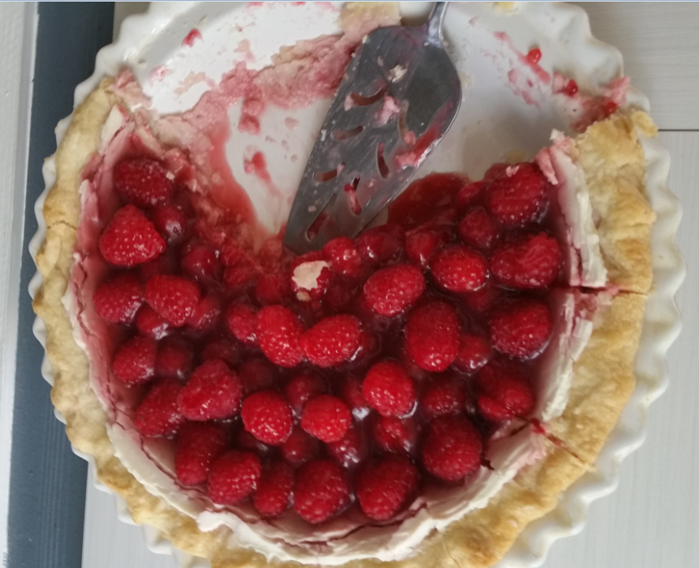
Time to talk about Raspberry Pie

Slide 12
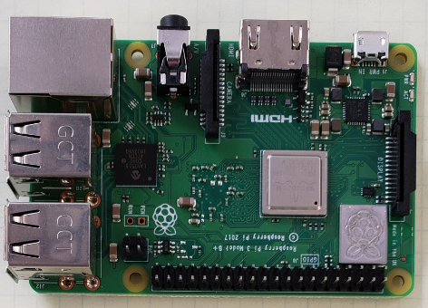
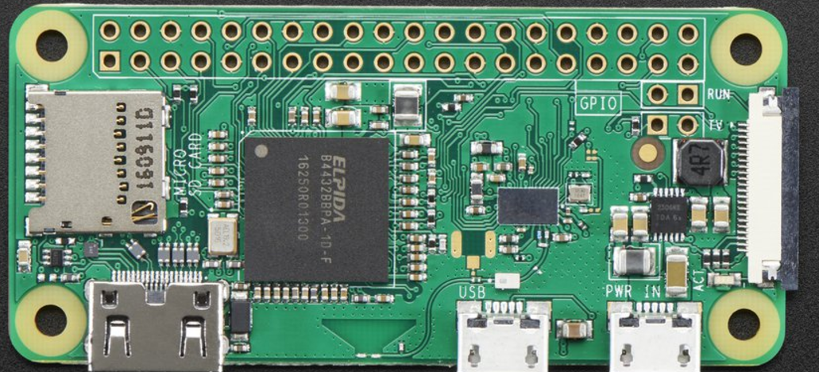
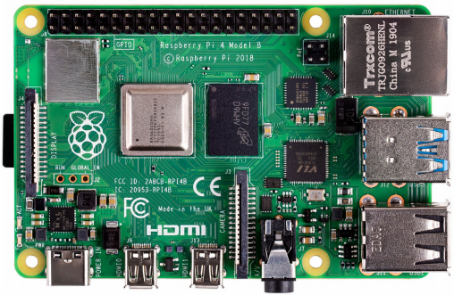
Raspberry Pi
Advantages
Linux operating system. Can program in many languages and interact with the internet.
Can make Webpages and run full LAMP stack.
Massive open source software and hardware support.
Very fast ARM core processor.
Easy to implement GUI’s for interactive programs.
Disadvantages
Need to add on hardware for Analog inputs.
Power hungry when compared to other micro controllers.
Operating system overhead.
Heat dissipation on newer versions

Slide 13
Difference between the Raspberry Pi Versions
Model | Zero/W | B | Pi 3 A+ | B+ | Pi 2 | Pi 3 | Pi 3+ | Pi 4
CPU | Arm 6 1000MHz | Arm 6 700MHz | 4xArm 53 1400MHz | Arm 6 700MHz | 4xArm 7 900MHz | 4xArm 8 1200MHz | 4xArm 53 1400MHz | 4xArm 72 1500MHz
RAM | 512MB | 512MB | 512MB | 512MB | 1GB | 1GB | 1GB | 1GB/2GB/4GB
USB | 1 | 2 | 1 | 4 | 4 | 4 | 4 | 2-2.0 2-3.0
Network | None/Wi-Fi | 10/100 | Wi-Fi | 10/100 | 10/100 | 10/100 Wi-Fi bg | 10/300 Wi-Fi abg | 10/100/1G Wi-Fi abg
Video | HDMI | HDMI/NTSC/PAL | HDMI/NTSC/PAL | HDMI/NTSC/PAL | HDMI/NTSC/PAL | HDMI/NTSC/PAL | HDMI/NTSC/PAL | 2XHDMI NTCS/PAL
Hardware IO | 25 | 17 | 25 | 25 | 25 | 25 | 25 | 25
+5V Supply | 500mA | 1A | 1A | 1A | 1.5A | 2.0A | 2.5A | 3.0A
Bluetooth | Yes/W | No | Yes | No | No | Yes | Yes | Yes
SD Card | Micro | Mini | Micro | Micro | Micro | Micro | Micro | Micro
Cost | $5/$10 | $30* | $25 | $25 | $35 | $35 | $35 | $35/$45/$55

Slide 14
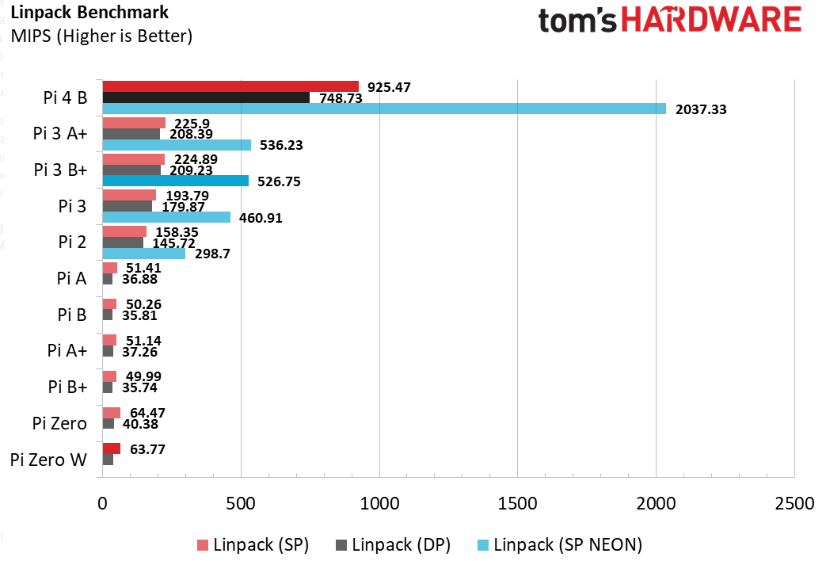
CPU Speed Benchmarks

Slide 15
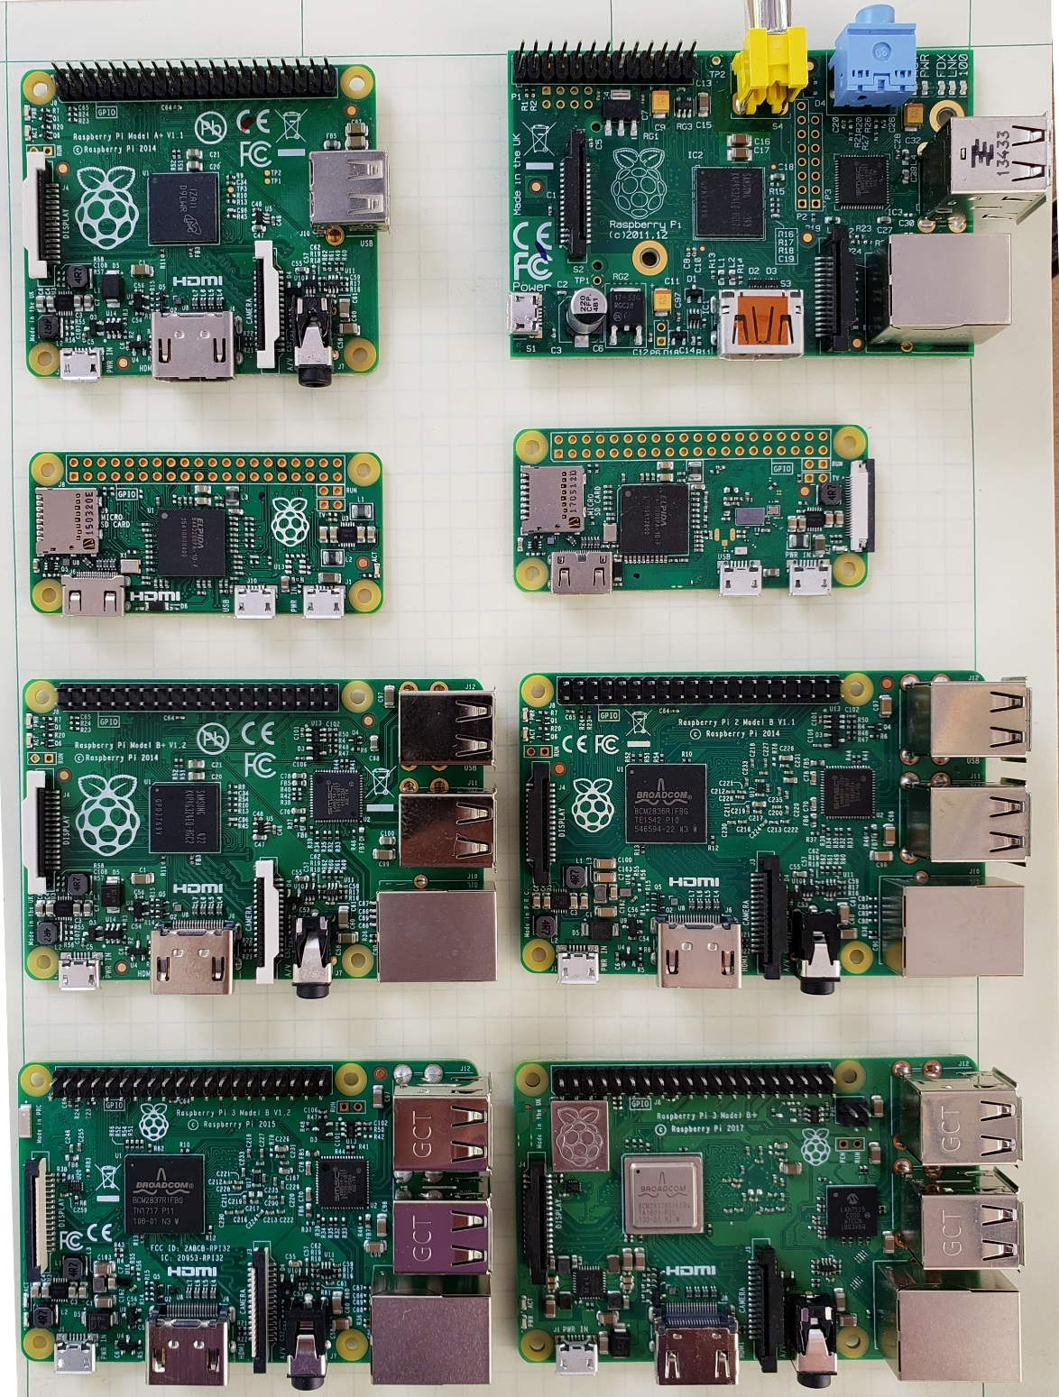
A+
B
Zero
Zero W
B+
Pi2
Pi4
Pi3
Pi3+

Slide 16

For More Maker Board Information
https://media.digikey.com/Resources/Maker/the-original-guide-to-boards-2019.pdf

Slide 17

Some Raspberry Pi Resources
TM Raspberry Pi Foundation www.raspberrypi.org
Good Links and web sites:
www.raspberrypi.org —The Foundation’s Website
www.raspberrypi.org/downloads — Various Raspberry Pi Operating Systems
www.tomshardware.com – Good Linux and Pi tutorials and reviews.
www.adafruit.com — Adafruit very good site for parts and tutorials
learn.adafruit.com/category/raspberry-pi —Many projects and how to’s at Adafruit
www.sparkfun.com —Raspberry Pi parts and many other Hobby parts. (Colorado Co.)
www.mcmelectronics.com —Low priced Raspberry Pi Parts
www.microcenter.com —Online and In Store Raspberry Pi
http://www.instructables.com/howto/Raspberry+Pi/ Lots of good Pi Tutorials
https://github.com/Chuckduey/CSU_Pi_Class.git GitHub page with the code from this class.
My email cduey@msn.com

Slide 18
Important Raspberry Pi Tips
Do Not add or remove hardware while running. Including USB devices. Plugging in a mouse at the last minute can kill the SD card.
Power down the Raspberry Pi using a software command before removing power. SD corruption is very common on uncontrolled power downs.
SD cards are fragile and also wear out. Keep a backup copy of your code. It is best to store it on a network drive.
SD cards come in various speeds and sizes. Class 10 is the fastest. For the Raspberry Pi 32GB is the maximum sized. (SD limitation)
The Raspberry Pi I/O ports are 3.3V. A 5V signal will render the port, and possibly the whole Pi useless.
The Micro SD cards are very easy to pop out accidentally. If it does while it is running, resist the temptation to plug it right back in. Power down first!!!

Slide 19
Useful Tools
Linux or MAC computer with USB and network.
With a Linux computer, it makes it easy to copy, change and back up Raspberry Pi SD cards using the “dd” command.
Also the ssh, and ssh –X makes it easy to remote in to work.
Win32 Disk Imager - A perfect tool copying and backing up Raspberry Pi SD cards. Do not do a direct SD to SD copy.
PuTTY - creates a terminal window that can be used to “ssh” to any Linux computer on you network from a windows machine.
VNC/ RealVNC – VNC can display a desktop to another computer Linux or Windows. Very nice for remote work from different platforms.
USB power 2.5A or more - While most computers are limited to 500mA of current on the USB port, it is easy to have more that that draw from a Raspberry Pi with accessories.

Slide 20
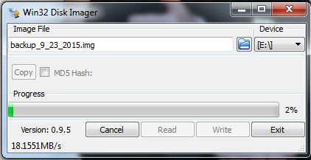
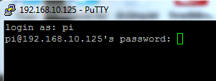
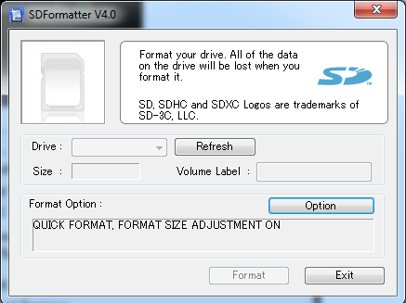
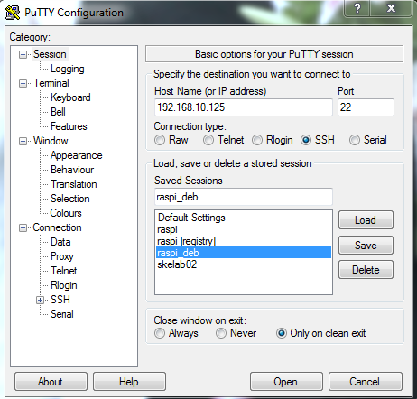
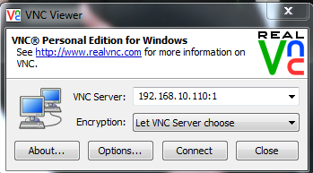
Useful Windows Tools

Slide 21
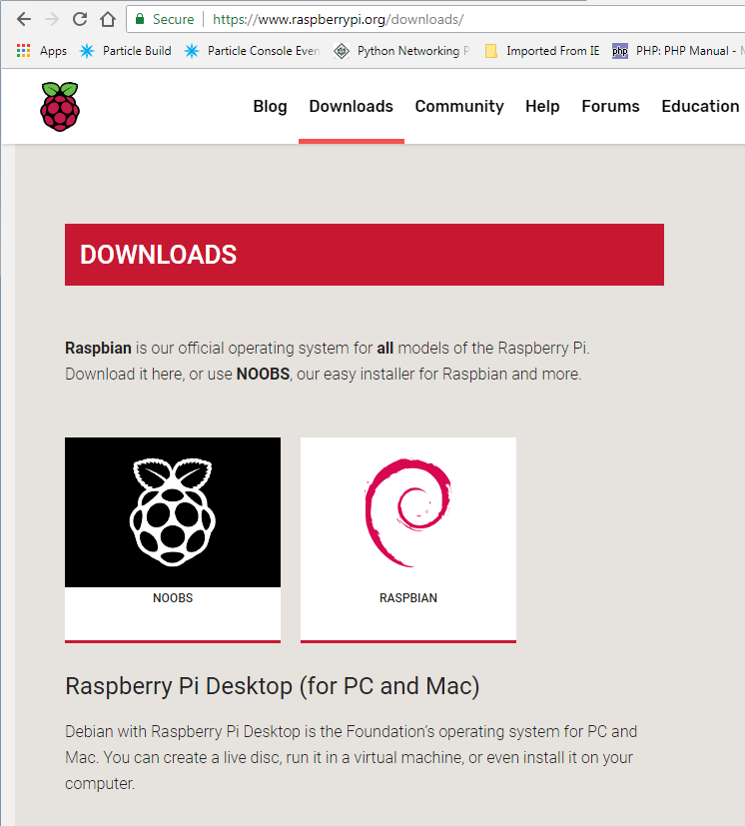
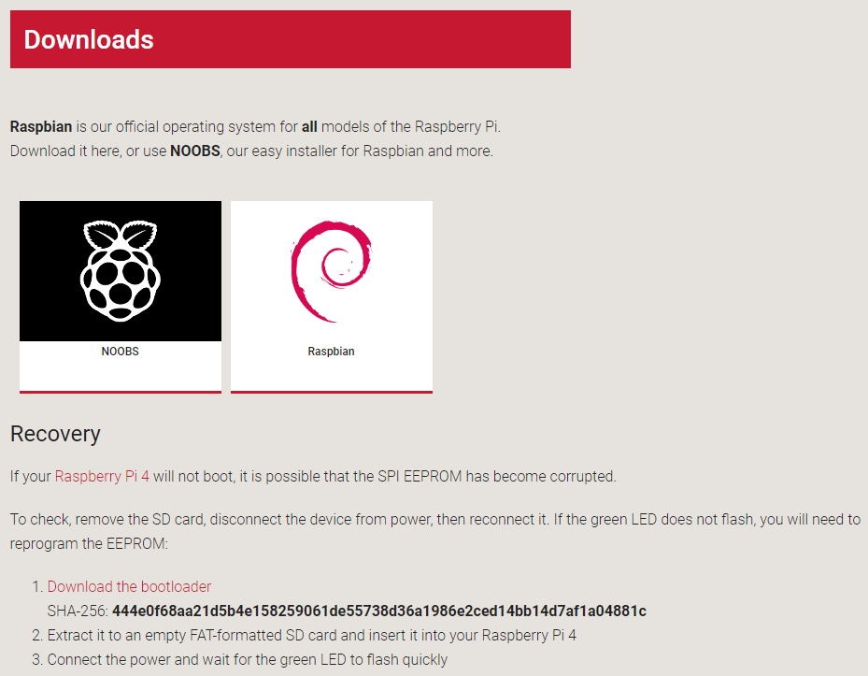
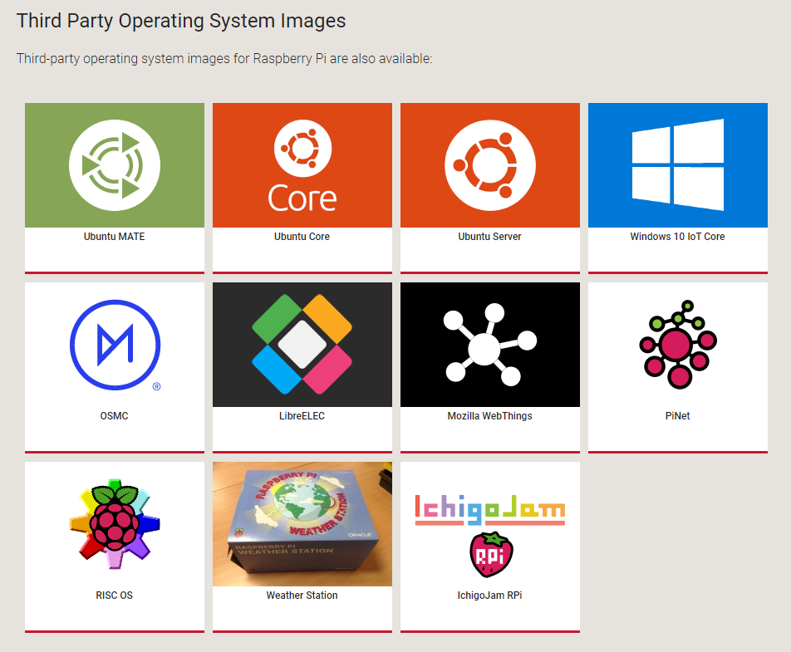
How do you get an OS: NOOBS
www.raspberrypi.org/downloads

Slide 22








Raspberry Pi Raspbian Versions
Initial Release Date | Current Release Name | Debian Version | Linux Kernel | GCC | apt | X Server | Raspberry Pi 1/1+ | Raspberry Pi 2 | Raspberry Pi 3 | Raspberry Pi 3+ | Raspberry Pi 4
2013-09-27 | 2015-05-05 | 7 (Wheezy) | 3.18 | 4.7.2 | 0.9.7 | 7.7
2015-09-28 | 2017-07-05 | 8 (Jessie) | 4.9 | 4.9 | 1.0.9.8.1 | 7.7
2017-09-08 | 2019-04-08 | 9 (Stretch) | 4.14 | 6.3 | 1.4.9 | 7.7
2019-06-24 | 2019-07-10 | 10 (Buster) | 4.19 | 8.3 | 1.8.2 | 7.7
Bullseye
Buster
©

Slide 23
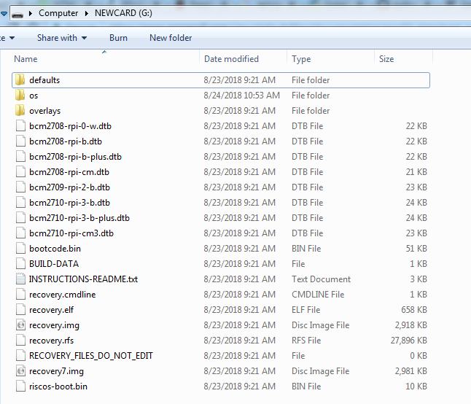
For NOOBS extract files and copy to fresh SDCard 32GB or smaller, and bigger than 16GB

Slide 24
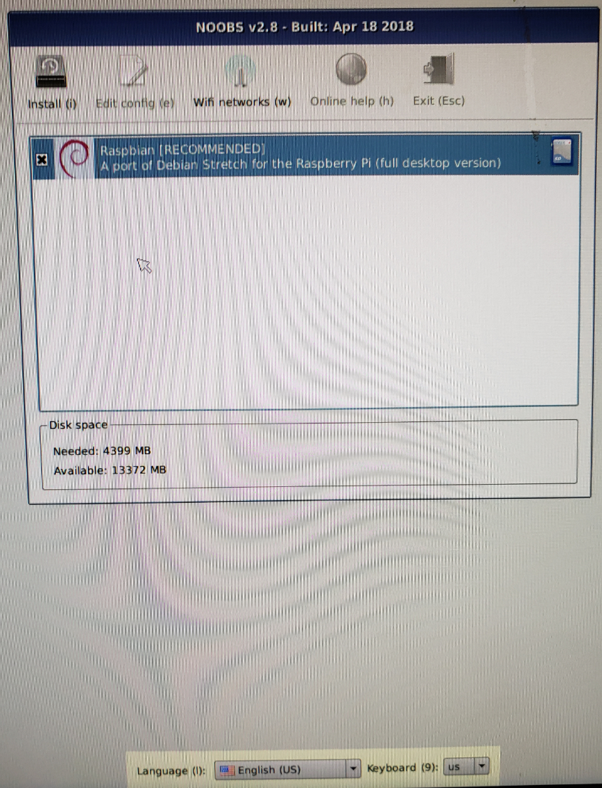
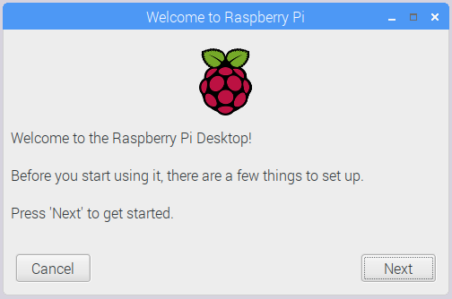
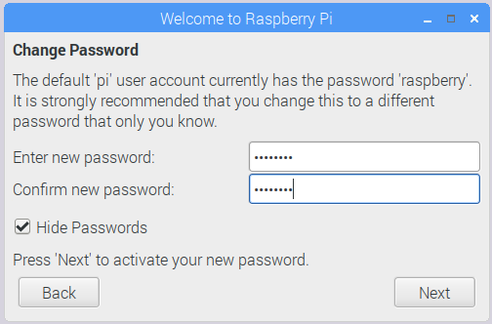
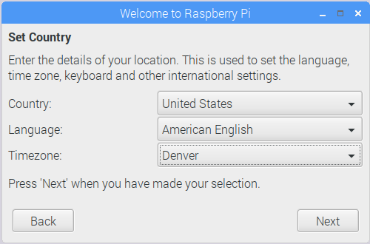
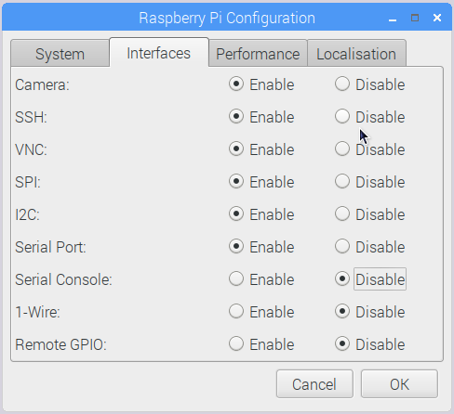
Install Raspian
!
Set US Keyboard!

Slide 25
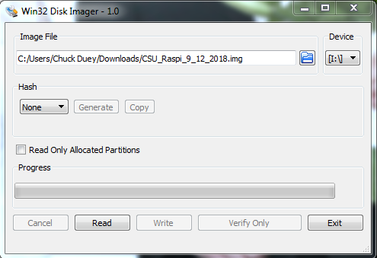
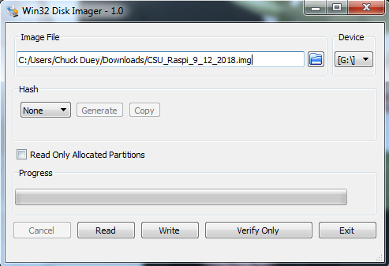
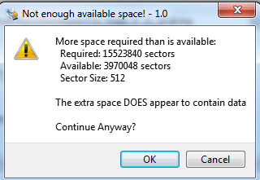
Quick Word on SD Cards They are not all the same.
Backup your files!!!! SD Cards will get corrupted.
When you copy an image, actual SD card size can vary by more than a GB. To burn to a new card the image size or bigger is needed! Both Windows and Linux copies will have this problem
If Linux dd is used, make sure to copy the root image. /dev/sdX not /dev/sdX0,1..

Slide 26
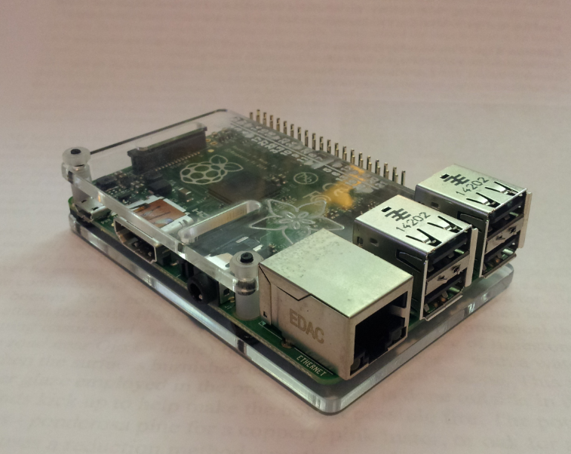
Hooks ups for your Raspberry Pi
10/100 Network
3. Power
1. HDMI
2. USB
Audio/Analog Video

Slide 27
Hook up your Raspberry Pi
Round up the components. Pi, HDMI cable and display, power supply, power cable, USB mouse and USB keyboard.
Plug in the HDMI to the display and Raspberry Pi.
Plug in USB mouse and keyboard.
Plug in power cable on Raspberry Pi end, and then plug in power.
Watch HDMI display and make sure it is booting.
If it is not booting un plug power and check the SD card.
Do not Plug in or remove hardware components while the Pi is powered! It can cause flash corruption.

Slide 28
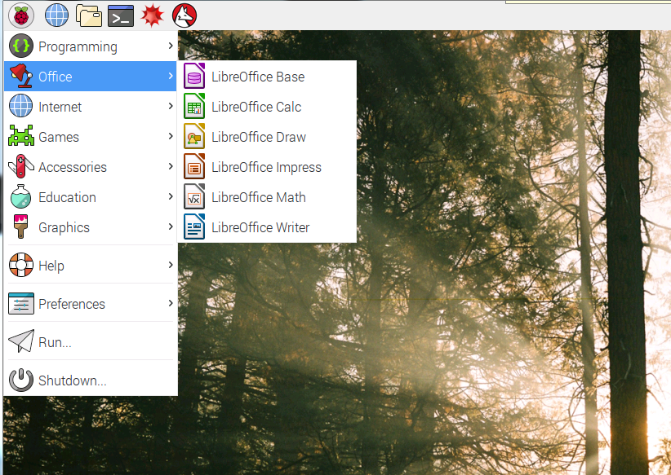
Raspberry Pi Raspian Buster

Slide 29
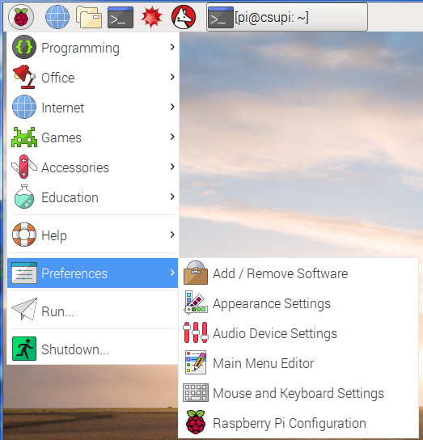
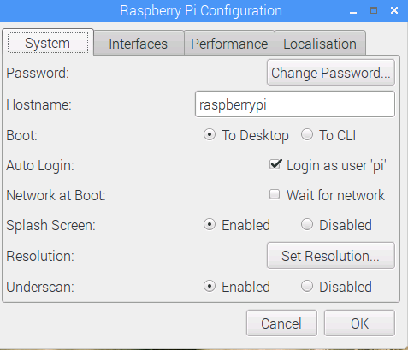
New Raspi-Config

Slide 30
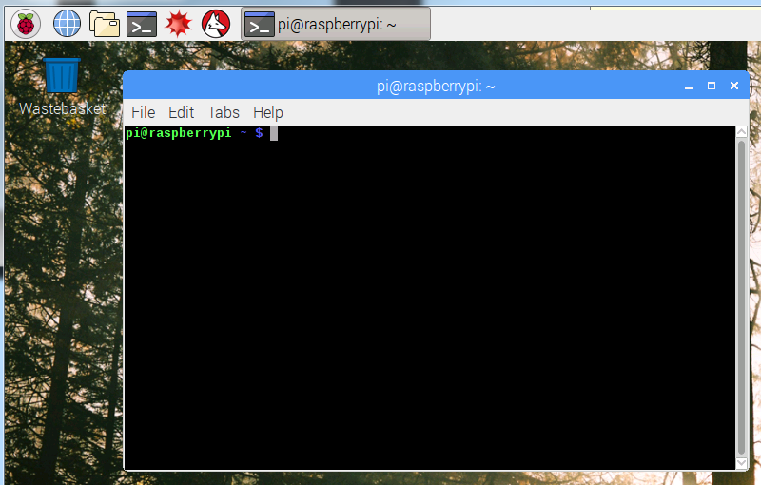
Terminal Window
Click here once

Slide 31
Terminal window commands
https://www.tomshardware.com/reviews/raspberry-pi-command-line-commands,6159.html
ls = list files in directory ls –l = List long ls –a = List all
cd (dir name) = change directory
df –h = Show file systems sizes and usage
nano (file) = Simple intuitive text editor
vi (file) = Simple powerful non-intuitive text editor.
cat (file) = output the contents of a file
less (file) = output a file one page at a time
apt install (package) = get a package to install
apt update = update packages
apt-cache show (key word) = show available packages
sudo = next command execute as root
ifconfig = show the ip interface connections

Slide 32
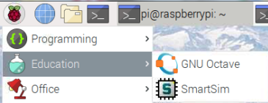
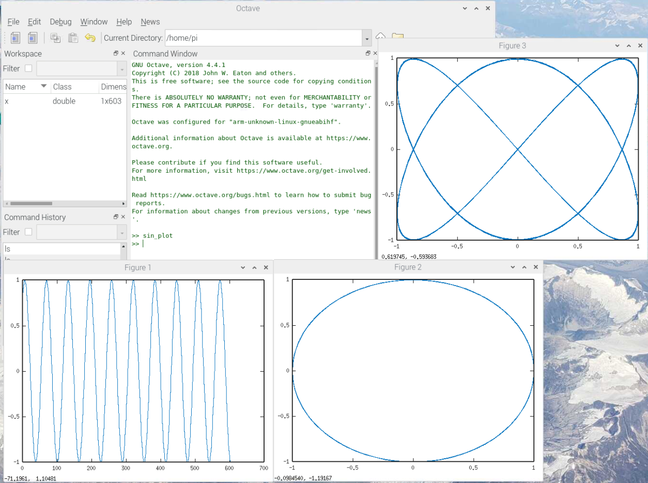
Fun with Octave
>> sin_plot
Exit When done.

Slide 33

Matlab® and Raspberry Pi
>> rpi = raspi(‘Address',‘User',‘Password');
>> mcp3208 = spidev(rpi, 'CE0');
>> for i=1:8
[v(i),t(i)] = DAC_Read(mcp3208,i);
end
>> t
t = 66.4532 65.7501 67.1563 66.5411 67.0684 67.1563 67.5958 67.7716
>> scanI2CBus(rpi,'i2c-1')
ans = 1×4 cell array
'0x20' '0x39' '0x3E' '0x68'
Matlab only runs on PC, or other Intel/AMD computers.
Matlab can connect and run commands that controls hardware.
The Student version of Matlab comes with all the controls, many tool boxes and Simulink.
The Student version can ONLY be used by students to meet course requirements and perform research at degree granting institutions.

Slide 34
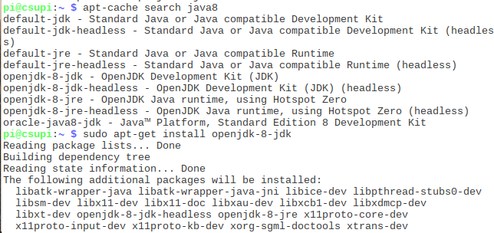
Ways to get applications and software packages
apt-cache search [package]
sudo apt install [package] octave, mysql, git, python-pip…
pip install ‘Some Application’
sudo easy_install –U [Python Package] spidev, Rpi.GPIO
git clone git://[package site] git.osmocom.org/rtl-sdr-git
Download “tgz” file. tar –xzf package.tgz

Slide 35
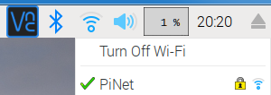
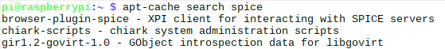
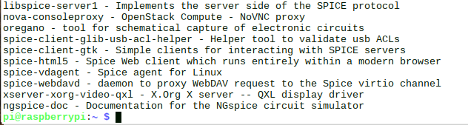
Connect to internet and download package
Verify Connection to Wireless
Open a web page to www.google.com
Open a terminal and “apt-cache search spice”
sudo apt install oregano
<- install oregano spice simulation program ->

Slide 36
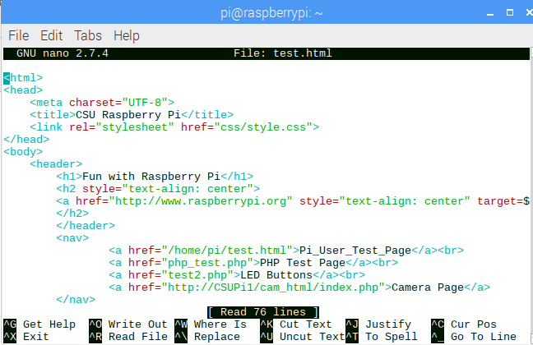
Web Pages
It is very easy to set up a Raspberry Pi to serve Web Pages
Open a web browser and go to “localhost” click on the “Pi_User_Test_Page” link
Now in a terminal window
cd CSU_Pi_Class
edit the test.html file in your home directory using nano.
nano test.html
<ctl-o><ctl-x> to save
Refresh the webpage to
See your edits.

Slide 37

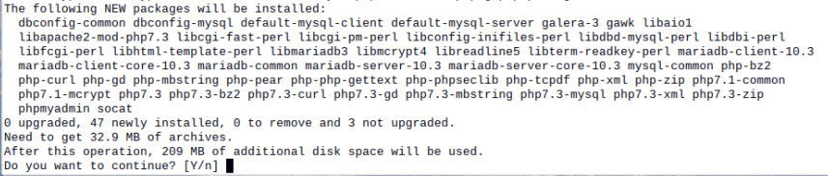
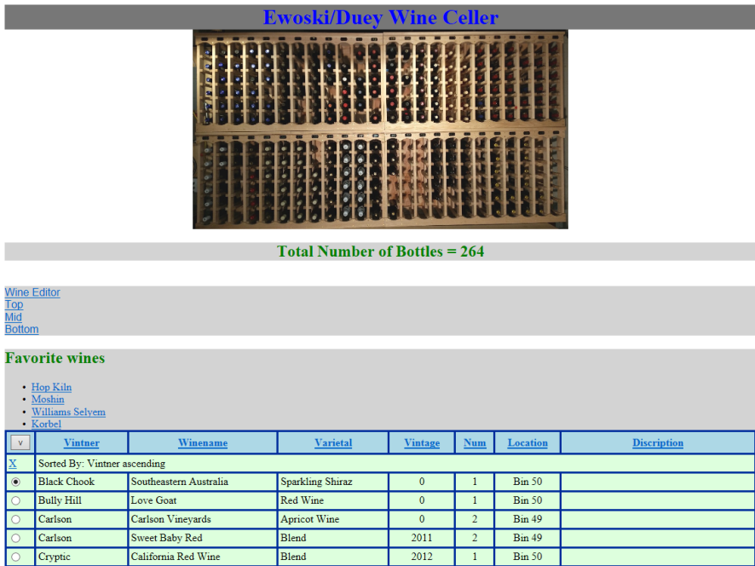
Full LAMP Stack (Linux Apache MySQL PHP)

Slide 38
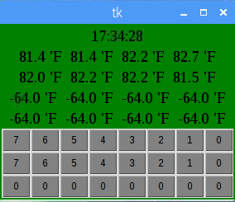



GUI’s via Python Tkinter, Pygame, Qt, GTK+ and Wx Widgets

Slide 39

Raspberry Pi as Wireless Access Point
Addon Hardware
https://learn.adafruit.com/setting-up-a-raspberry-pi-as-a-wifi-access-point?view=all

Slide 40

SDR and GNURadio Example
Addon Hardware

Slide 41

GNURadio and Raspberry Pi 10.5 GHz Radar Test Range
Addon Hardware

Slide 42

One more SDR Example Receiving NOAA Satellite Data
Addon Hardware
http://www.instructables.com/id/Raspberry-Pi-NOAA-Weather-Satellite-Receiver/

Slide 43

Touch Screen from RPi Foundation
Addon Hardware

Slide 44



Addon Hardware Pi Camera – uses built in port.
Addon Hardware

Slide 45

Camera and Web Page
Addon Hardware
Open Web browser to home page and click “Camera_Page”
https://elinux.org/RPi-Cam-Web-Interface

Slide 46

SmartiPi With Camera

Slide 47

Raspberry Pi I/O*
UART/Serial – 2 Wire interface 3.3V
Good for GPS, RS-232 Monitor, and many others.
Baud rates up to 115200 bps
SPI Serial 4 Wire interface. (MOSI, MISO, SCLK, CE) 3.3V
2 Chip Selects built in. Easy connections to many serial sensors.
Speeds can be between 8KHz to 125MHz
This can be used to run an LCD Screen
I²C Serial 2 Wire Interface. (SDA, SDL) 3.3V
Multiple devices with 7 bit address. Up to 127 - 11
Much slower 400Kbps For Raspberry Pi.
Great for touch screen sensors.
* From www.raspberrypi.org/forums

Slide 48


GPIO Pin out*
All Others Extra pins
Note: GPIO pins are 3.3V Only
A 5V input will cause damage to the Raspberry Pi!!!
Pi A and B Pin Out
*From http://pi.gadgetoid.com/pinout

Slide 49

Pi Hats – Hardware for the Raspberry Pi

Slide 50





Other Addon Boards
Cirrus Logic Audio Card
Gertboard
Adafruit Proto Bonnet
Pimoroni DAC Bonnet
Adafruit OLED Bonnet

Slide 51




Franken Chiller Brewery Control

Slide 52




Now For Fun and Games with the Pi

Slide 53


Looking at the I2C bus HTS221
i2cdetect –y 1
i2cdump –y 1 0x5f
Humidity registers = 0x29 0x28
Temperature registers = 0x2b 0x2a

Slide 54



More I2C Fun
i2cget –y 1 0x5f 0x20
i2cset –y 1 0x5f 0x20 0x81
i2cget –y 1 0x5f 0x20
Humidity registers = 0x29 0x28
Temperature registers = 0x2b 0x2a
i2cdump –y 1 0x5f

Slide 55

Geany – A Good Generic Programming IDE

Slide 56

Hello World! Geany
Change the code, save and run it.

Slide 57

Hello World! Geany
Compile the code
Then Run it

Slide 58

Accelerometer.
Type: Open accel.py in Geany
Hit Run and tilt the Pi

Slide 59

Weather station
Inside Geany open the MiniWeatherStation.py

Slide 60

Copy and pasting between windows.
In a terminal window type: python
Select from Geany, go to Python window and center click:
>>> from sense_hat import SenseHat
>>> sense = SenseHat()
>>> sense.clear()
>>> sense.show_message(“Your Message”, text_colour=[255, 0, 0])
When done.
>>> exit()

Slide 61


Sense Hat – Chuck Maze
Use Default Maze

Slide 62


Pi Sense Hat – Chuck Paint

Slide 63
Arduino and Raspberry Pi
One interesting addition that can be made is to use an Arduino platform for low level hardware control. The Raspberry Pi has the fast graphical display.
Connect the Circuit Playground to one of the USB ports of the Raspberry Pi.

Slide 64

Open Arduino IDE
Open Serial Monitor
Double click and Execute

Slide 65

Arduino to Pi Communication
Open monitor
Enter LED# + RGB code
Serial data coming to the Pi

Slide 66


Run the game_circle.py app.
What happens when it is leveled

Slide 67
GitHub – Great Collaboration Tool
For opensource projects it is Free.
Size limit is 1GB, and no file bigger than 100MB.
You can start a Repository and control who can change it.
Changes can be made and tracked.
Branches of code and Tags can be generated.
Private Repos and Closed Repos can be made, but require a monthly fee.
It is a great way to have an opensource project with collaboration.

Slide 68
Thanks !!! Have Fun With Raspberry Pi
Code is available at https://github.com/Chuckduey/CSU_Pi_Class.git

